Slide 1
DESIGN (ANTI-)PATTERNS
Coffee Break
Bridge

Slide 2
WHAT ARE DESIGN PATTERNS
A software design pattern is a general, reusable solution to a commonly occurring problem. It is not a finished design that can be transformed directly into source or machine code. It is a description or template for how to solve a problem that can be used in many different situations. Design patterns are formalized best practices that the programmer can use to solve common problems when designing an application or system.
Types
Creational (singleton, builder, lazy init, abstract factory, object pool etc.)
Structural (adapter, bridge, decorator, facade, composite, proxy etc.)
Behavioral (iterator, strategy, template method, visitor, command etc.)
Concurrency (thread pool, double checked locking, monitor object, reactor etc.)

Slide 3
BRIDGE
The bridge pattern is used to decouple an abstraction from its implementation so that the two can vary independently.
Concept
structural pattern
The bridge pattern is useful when both the class and what it does vary often.
Abstraction = class that interpose services
Implemantation = class that offers those services

Slide 4
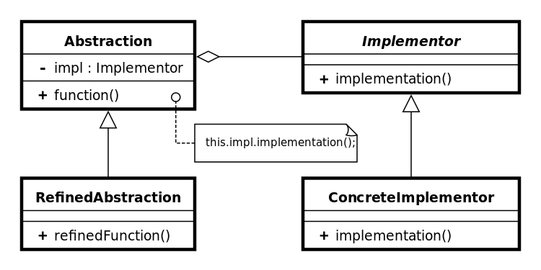
UML class diagram
Abstraction (interface or abstract class)
defines the abstract interface
maintains the Implementor reference.
RefinedAbstraction (normal class)
extends the interface defined by Abstraction
Implementor (interface or abstract class)
defines the interface for implementation classes
ConcreteImplementor (normal class)
implements the Implementor interface

Slide 5
BRIDGE
Principles
Bridge patterns decouple the abstract class and its implementation classes by providing a bridge structure between them.
This bridge uses encapsulation, aggregation, and inheritance to separate responsibilities into various classes
The abstraction is an interface or abstract class and the implementor is also an interface or abstract class.
The abstraction contains a reference to the implementor. Children of the abstraction are referred to as refined abstractions, and children of the implementor are concrete implementors. Since we can change the reference to the implementor in the abstraction, we are able to change the abstraction’s implementor at run-time. Changes to the implementor do not affect client code.
It increases the loose coupling between class abstraction and it’s implementation.

Slide 6
BRIDGE
Bridge example
Suppose there is a company that manufactures various types of vehicles like bikes, cars and buses.
There are frequent changes in vehicle, as new models of bikes and cars can be introduced and have different processes to manufacture them
There are different art of work that needs to be performed to produce the vehicle ( produce, assembly, paint )

Slide 7
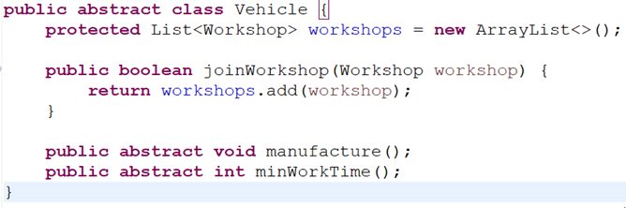
BRIDGE
Example Bridge implementation
Create basic Abstraction class

Slide 8
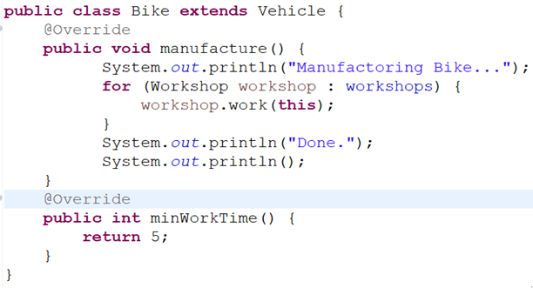
BRIDGE
Example Bridge implementation
Create refined Abstraction class

Slide 9
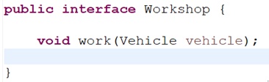
BRIDGE
Example Bridge implementation
Create Implementation interface ( bridge )

Slide 10
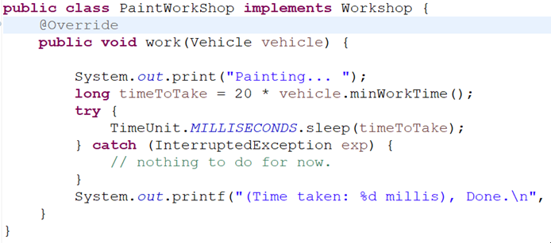
BRIDGE
Example Bridge implementation
Create refined Implementation

Slide 11
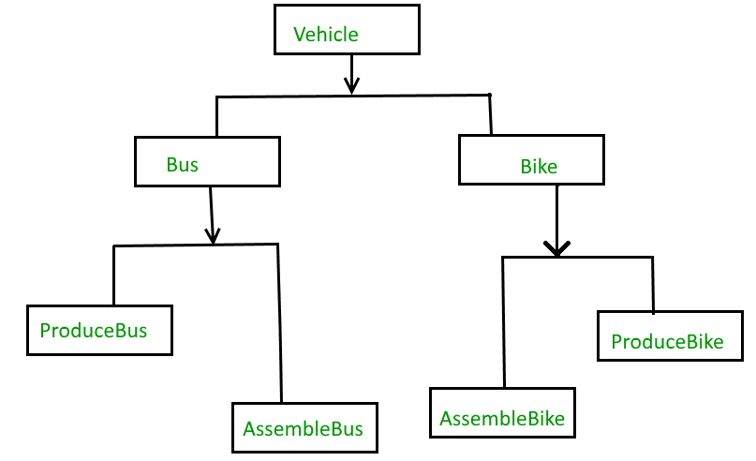
BRIDGE
When we need Bridge pattern ?
The above example can also be done something like this :
This solution has a problem. If you
want to change the Bus class, then
You may end up with changing
ProduceBus and AssembleBus as
Well and if the change is workshop
Specific than you may need to
change the bike class as well.

Slide 12
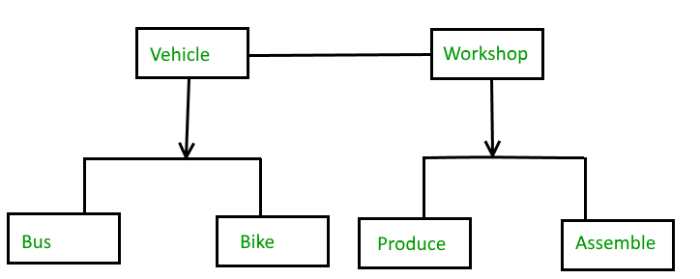
BRIDGE
When we need Bridge pattern ?
The problem above can be solved by decoupling the Vehicle and Workshop interfaces :

Slide 13
STRATEGY
Sources
https://en.wikipedia.org/wiki/Bridge_pattern
https://dzone.com/articles/bridge-design-pattern-in-java

Slide 14
STRATEGY
Questions and discussion

